Slide 1
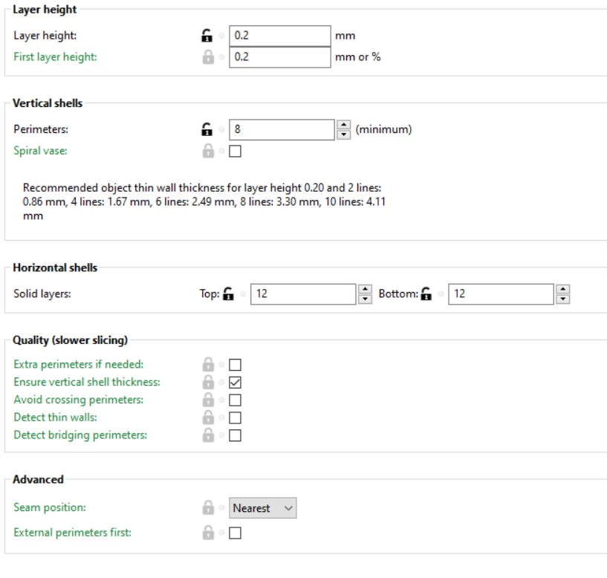
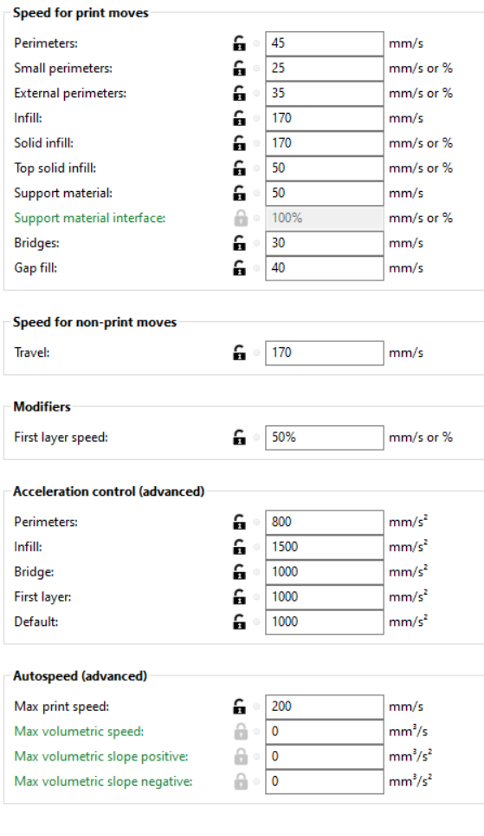
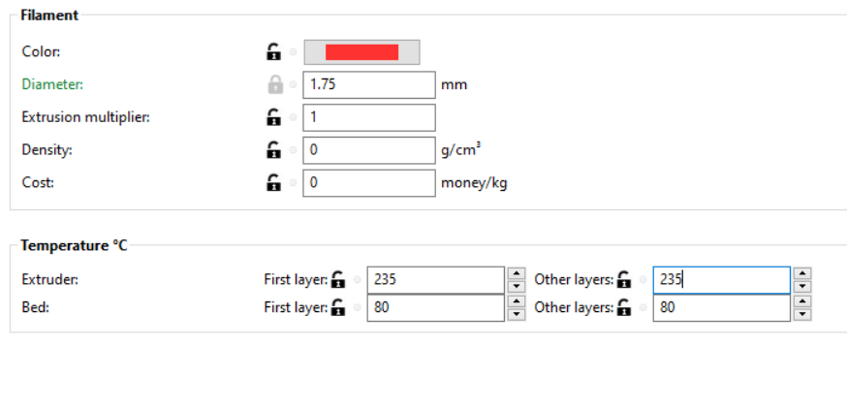
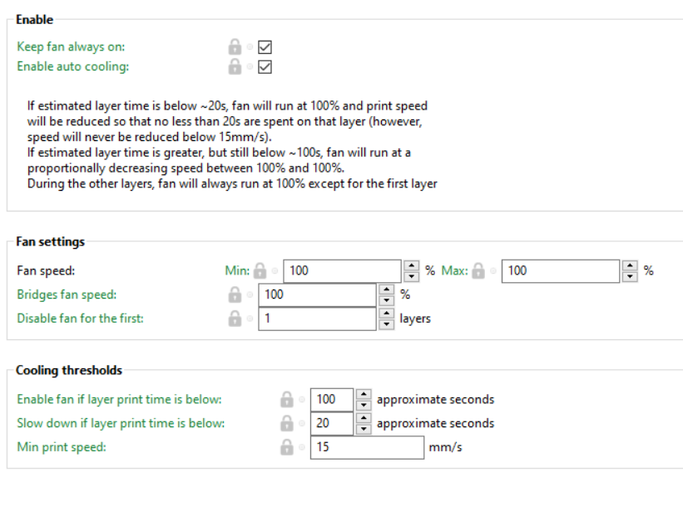

Slide 2
Printing Problems?
Check the Layer Height. Is it 0.2mm?
Check the Infill Density (it should be 100%).
Infill Pattern – I set mine to lines or zig zag typically.

